Slide 1
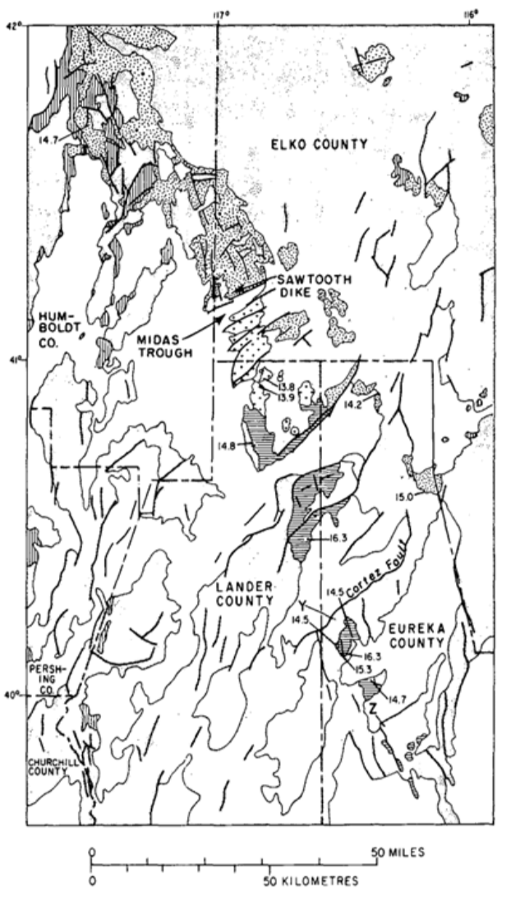
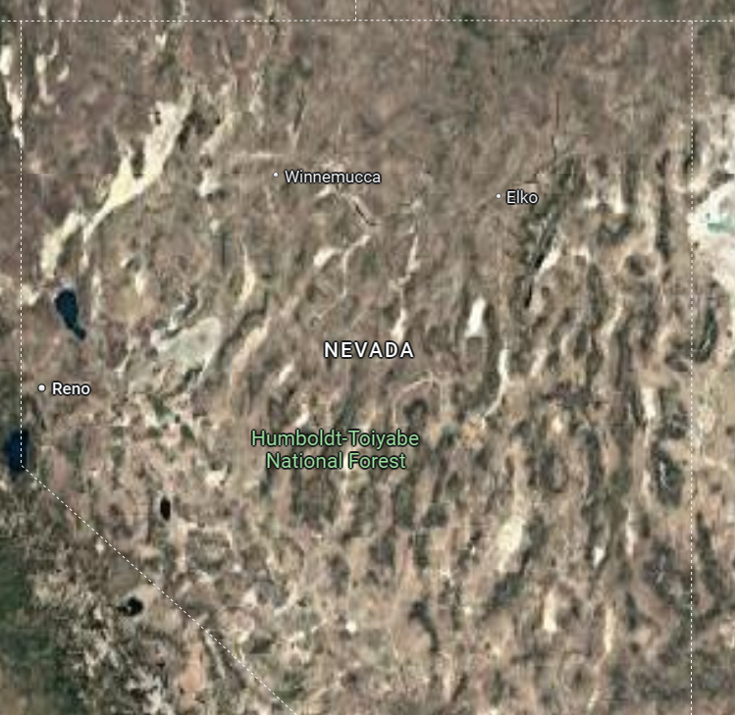
Basin and Range rifting in northern Nevada: Clues from a mid-Miocene rift and its subsequent offsets
M.L. Zoback & G.A. Thompson, 1978
What was the extension direction in north-central NV when B & R faulting began mid-Miocene?
When did this direction change, and to what extent?
How is it related to changes in the plate tectonic regime?

Slide 2
Mid-Miocene Extension
Northern NV rift aligns with positive aeromagnetic anomaly & narrow belt of volcanics
Rift trends NNW and is ~700 km long
K-Ar ages of infilling volcanics between 16.5 – 13.8 Ma
Contemporaneous volcanism and normal faulting → northern NV rift formed ~17-14 Ma
Mid-Miocene extension perpendicular to rift – estimated to be N68°E - S68°W
Evidence from dike alignment

Slide 3
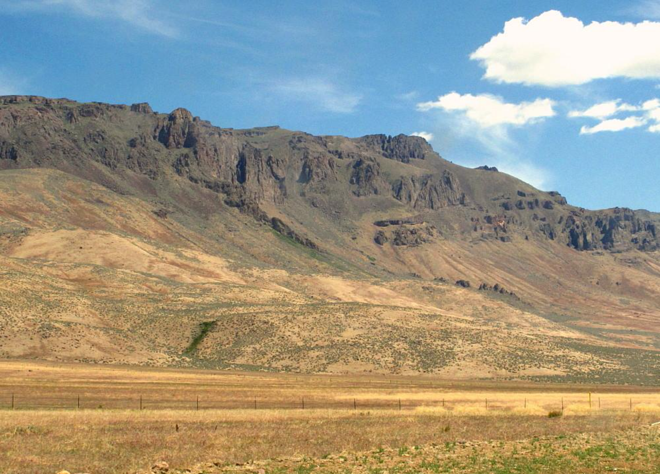
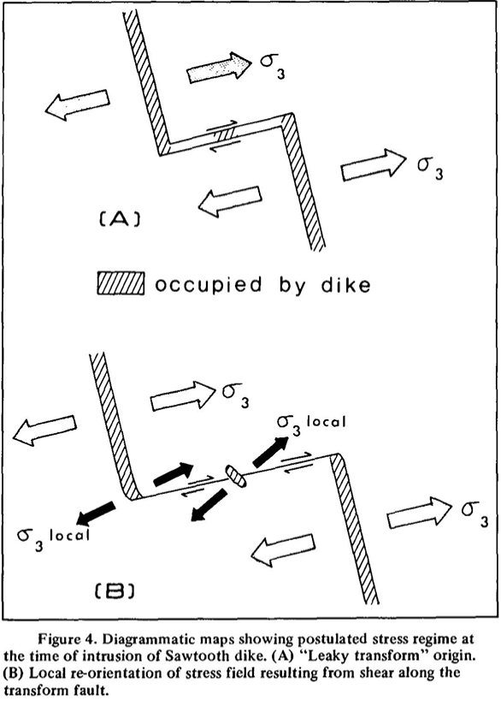
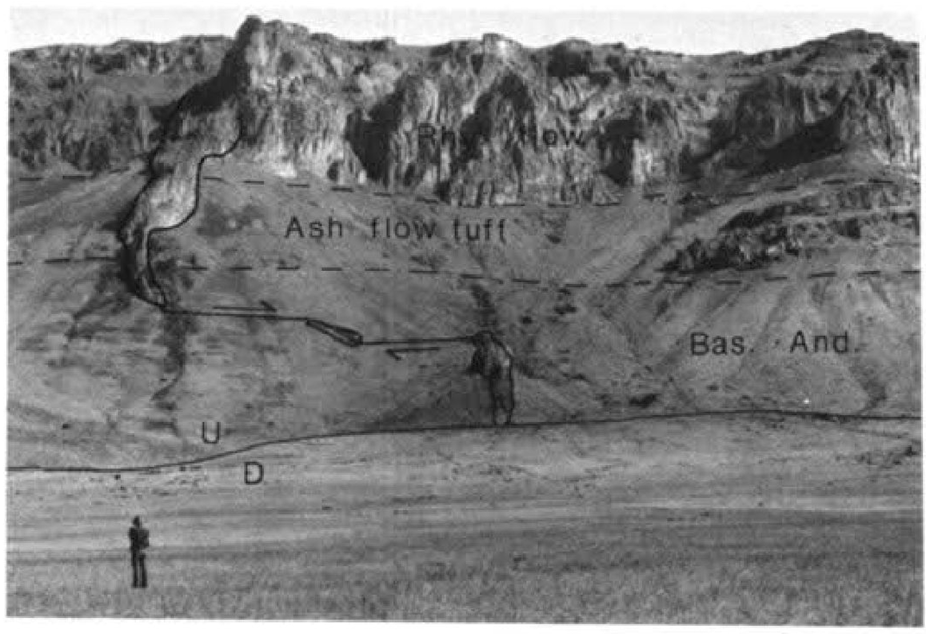
Evidence at Sawtooth Dike
Exposed along northern part of NV rift
Trends NNW
Strike-slip indicators confirm mid-Miocene extension direction
Offset interpretation:
Leaky R-lateral fault
Dike walls opened perpendicular to trend of strike slip fault
Consistent with extension along rift
Dike cut off by downdropped Midas Trough
Leaky!
Source: Looking for Detachment
U
D
Notes:
Vertical, 25 m long, porphyritic rhyolite, reversely magnetized

Slide 4
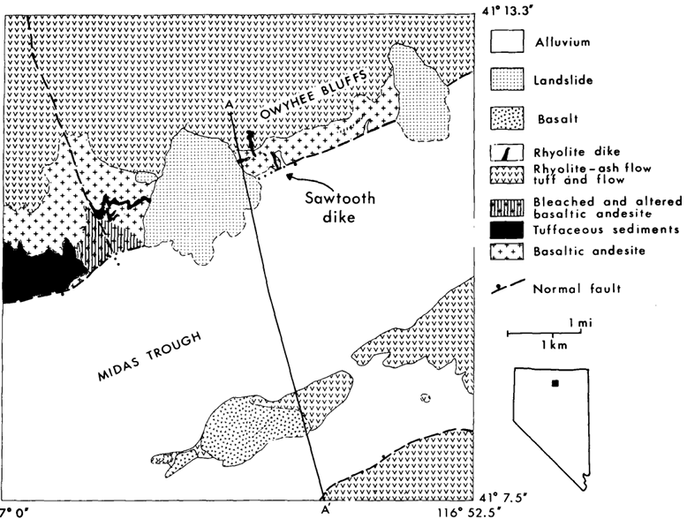
Timeline
Extension along rift – 17-14 Ma
Basaltic andesite – 15.1 ± 1.6 Ma
Intertongued with tuffs
Sawtooth dike – 14.3 ± 0.8 Ma
Normal faulting of Midas Trough – 15 – 6 Ma
Olivine-rich basalt – 6.3 ± 2.3 Ma
Allowed authors to constrain timing of NE trending fault system that cuts dike
Normal fault consistent with Miocene extension timing and direction
theorized to be conjugate faults to accommodate changes in extension direction
Notes:
Basalt flowed along trough floor and over alluviam

Slide 5
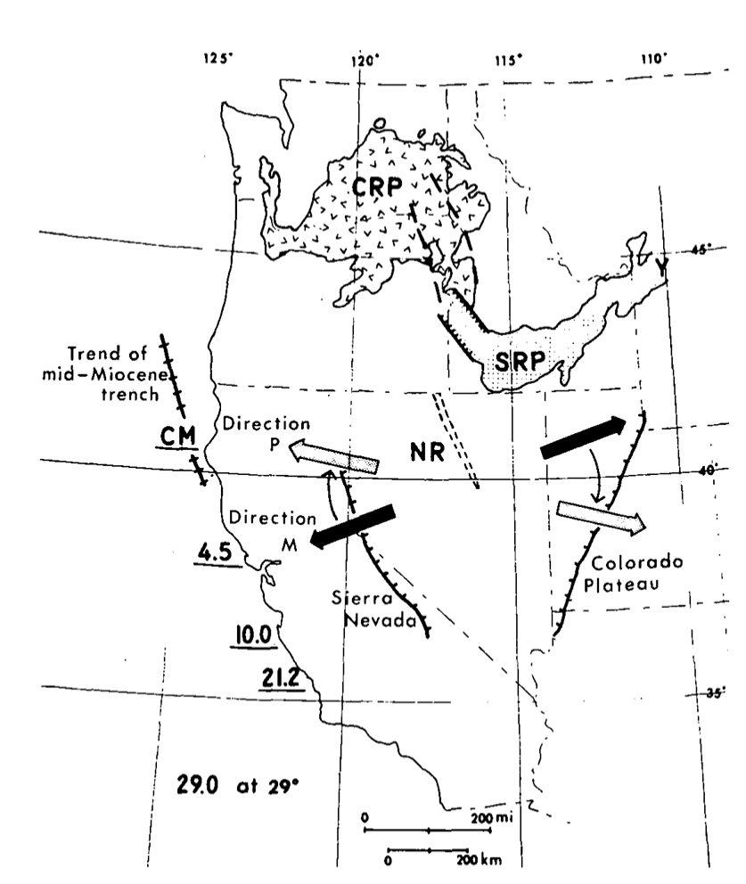
Present-Day Extension Direction
Consistent direction established by previous studies: N65°W – S65°E ± 20°
Evidence from: earthquake focal mechanisms, geodesy, volcanic vent & cinder cone chains, historical faulting
Indicates ~45° clockwise rotation since 14 Ma!
Theory: as plate boundary changed from convergent to transform, superposition of right-lateral shear occurred and caused clockwise rotation
M: Miocene and P: present extension. CRP: Columbia River basalts; SRP: Snake River Plain; Y: Yellowstone NP; CM: Cape Mendocino; dashes: Chief Joseph dike swarm.
Notes:
Inferred that SRP graben formed contemporaneously with deposition of CRP

Slide 6
Summary
Rifting in north-central NV began ~17-14 Ma
Part of ~700 km NNW-trending rift zone
Marks beginning of northern Basin & Range extension
Extension: ~N68°E - S68°W (pre - 14Ma)
Rifting was perpendicular to extension direction when plate boundary was subduction zone
Evidenced by consistent dike orientations
Extension rotated clockwise ~45° as plate boundary became R-lateral transform fault (activation of San Andreas system)
Extension: ~N65°W – S65°E (post - 14 Ma)
NE-trending normal faults may have been accommodation of change in spreading direction
Sawtooth dike area indicates direction change had begun by 6 Ma

